Slide 1
NN-kNN
Neural Case-Based Learning
Repository orientation for classification, regression, and CartPole RL workflows
learn retrieval
weight features
aggregate cases
adapt output
01

Slide 2
NN-kNN
What NN-kNN Is Here
A neural retrieval model that keeps case-based structure visible.
Case Base
Glocal Weighting
Prediction
Training examples remain stored as retrievable cases.
Queries compare against all stored cases in representation space.
Feature dimensions are reweighted during distance computation.
Activations are normalized over cases with softmax or sparsemax.
Classification sums activation into class probability mass.
Regression can use NN-CDH after retrieval for adaptation.
02

Slide 3
NN-kNN
Retrieval Pipeline
The maintained core stays common while task heads differ.
Input
Project
Distance
Normalize
Aggregate
`normalize_over_cases` selects case-level normalization behavior.
Retrieval-only output and post-adaptation output are reported separately in regression work.
The same core supports tabular classification, regression, and experimental RL actors/critics.
03

Slide 4
NN-kNN
Maintained Entry Points
Use workflow helpers rather than notebook-only implementations.
Core
Supervised
Reinforcement Learning
model/nnknn_model.py
model/nn_cdh.py
datasets/reg_data.py
model/regression_workflow.py
model/classification_workflow.py
tools/table1_nnknn_kfold.py
model/rl_workflow.py
model/nec_workflow.py
model/nnknn_rl_workflow.py
datasets/rl_tasks.py
04

Slide 5
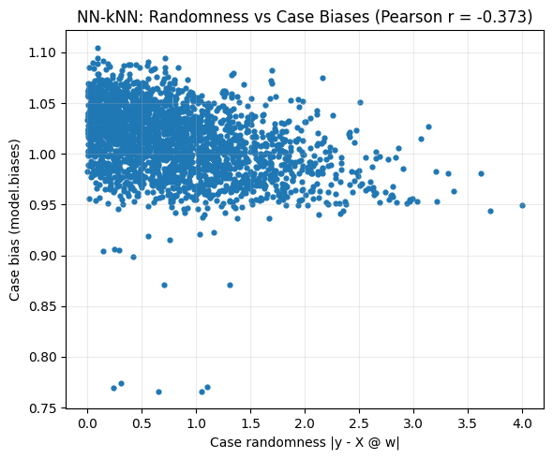
NN-kNN
Classification Workflow
Current classification uses the shared IJCAI-26 core.
Supported small datasets: iris, zebra, zebra_special, wine, breast_cancer, balance, digits.
Supported image workflows: MNIST, CIFAR-10, SVHN.
Baselines include kNN, MLP, ConvNet, and feature-kNN variants.
Text tasks are deferred to keep dependencies out of this workflow.
05

Slide 6
NN-kNN
Regression Workflow
Regression reporting centers on retrieval, adaptation, and repeated benchmarks.
Run
Compare
Report
Set `task_type="regression"` explicitly.
Prefer `model/regression_workflow.py` for orchestration.
Baselines: kNN(X), Oracle kNN, MLKR+kNN, MLP.
Keep the same split per method within a run.
Separate retrieval-only and post-NN-CDH results.
Use mean/std summaries from repeated runs.
06

Slide 7
NN-kNN
Table 1 Protocol
The paper-style regression table is scripted and restartable.
`tools/table1_nnknn_kfold.py` runs 5-fold CV across the current regression dataset list.
Rows distinguish pure retrieval, adaptation, locality, and locality plus adaptation.
Normalizers include softmax and sparsemax variants, with locality toggles.
Write fresh timestamped folders under `results/`; keep failed folders for postmortem comparison.
Recommended exports: summary_long.csv, runs_long.csv, table1_like.csv, transposed.csv, done.json.
07

Slide 8
NN-kNN
RL Baseline Protocol
CartPole comparisons use fixed environment-step budgets and periodic evaluation.
DQN
NEC
NN-kNN-RL
CleanRL-style baseline.
Use best checkpoint plus end-of-budget evaluation.
Repo-native NEC workflow.
Current fast reference remains below success threshold.
On-policy actor-critic with GAE.
NN-kNN or MLP actor; MLP or NN-kNN value critic.
08

Slide 9
NN-kNN
Current RL Status
Treat these artifacts as diagnostic, not solved benchmark claims.
DQN fast run selected eval mean return: 110.85 at 110k steps; below the 475.0 success threshold.
NEC fast run selected eval mean return: 450.55 at 150k steps; improved but still below threshold.
NN-kNN-RL smoke path validates plumbing only; current NN-kNN critic comparison reached 369.5.
Use `training_efficiency` before making sample-efficiency or paper-style claims.
09

Slide 10
NN-kNN
Fast Validation
Small checks keep routine development cheap.
`python codex/smoke_test.py --mode imports`
`python codex/smoke_test.py --mode train`
`python codex/smoke_test.py --mode classification`
`python codex/smoke_test.py --mode rl`
`python codex/smoke_test.py --mode nec`
`python codex/smoke_test.py --mode nnknn_rl`
Use synthetic datasets for quick validation unless the task requires larger real datasets.
10

Slide 11
NN-kNN
Working Rules
A few guardrails prevent confusing experiments.
Treat `Outdated...` notebooks as archival only.
Use notebooks for inspection; put serious repeated reporting in workflow/helper Python files.
Do not overwrite run folders; create new timestamped artifacts under `results/`.
For RL, fixed budgets plus best-checkpoint selection are required for fair DQN, NEC, and NN-kNN-RL comparisons.
If success thresholds are never reached, interpret the run as possible underfit or unsolved.
11

Slide 12
NN-kNN
Recommended Next Slides
Where to extend this deck for a talk or paper meeting.
Add one architecture figure for `NN_KNN_Model` and `GlocalFeatureWeight`.
Add a Table 1 result slide after the next full k-fold run.
Add RL learning curves only after a solved or clearly plateaued fixed-budget run.
Add qualitative retrieval examples for Iris/Zebra and one regression dataset.
12

